Slide 1
Chapter 9 Relations
9.1 Relations and Their Properties
9.2 n-ary Relations and Their Application
9.3 Representing Relations
9.4 Closures of Relations
9.5 Equivalence Relations
9.6 Partial Orderings

Slide 2
9.4 Closures of Relations
Reflexive Closure
Symmetric Closure
Transitive Closure
【Definition】The closure of a relation R with respect to
property P is the relation S with property P containing R
such that S is a subset of every relation with property P
containing R.
The smallest relation with property P containing R

Slide 3



9.4 Closures of Relations
1. Reflexive Closure
【 Theorem 】 Let R be a relation on A. The reflexive closure
of R, denoted by r(R), is
The diagonal relation on A
Proof:
① containing R
② is a reflexive relation
③ is the smallest reflexive relation which contains R
Suppose that R' is a reflexive relation containing R, then

Slide 4



9.4 Closures of Relations
【 Corollary 】 ⇔ R is a reflexive relation .
Proof:
① The reflexive closure is a reflexive relation
② Since R is a reflexive relation,

Slide 5

9.4 Closures of Relations
Question:
Given R, how to obtain its reflexive closure?
  Add to R all ordered pairs of the form (a,a) with a∈A, not in R
  Add loops to all vertices on the digraph representation of R.
  Put 1’s on the diagonal of the connection matrix of R.

Slide 6



9.4 Closures of Relations
〖Example 1〗 , What is r(R)?
  Solution:

Slide 7

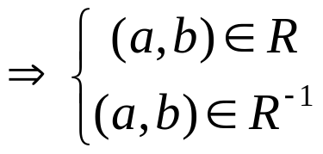




9.4 Closures of Relations
2. Symmetric Closure
【 Theorem 】 Let R be a relation on A. The symmetric closure
of R, denoted by s(R ), is
Proof:
① containing R
② is a symmetric relation

Slide 8

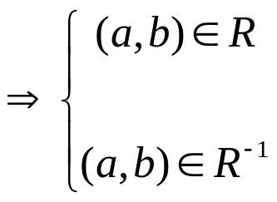
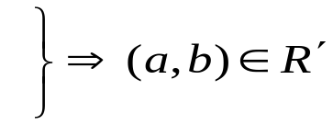








9.4 Closures of Relations
③ is the smallest symmetric relation which containing R
Suppose that R' is a symmetric relation containing R, then

Slide 9

9.4 Closures of Relations
〖Example 2〗 What is s(R) of the following relation?
a
b
d
c
  Note:
  Add an edge from x to y whenever this edge is not already in directed graph but the edge from y to x is.
  Add all ordered pairs of the form (b,a) where (a,b) is in the relation, that are not already in R.

Slide 10




9.4 Closures of Relations
【Corollary】 ⇔ R is a symmetric relation .
Proof:
① The symmetric closure is a symmetric relation
② Since R is a symmetric relation, it follows that

Slide 11



9.4 Closures of Relations
Recall:
  The transitive closure of a relation R, t(R), is the smallest transitive relation containing R.
  How can we construct t(R)?
    Can t(R) be produced by adding all the pairs of the form (a, c) where (a, b) and (b, c) are already in the relation?
    t(R)=?
  How to compute?
〖Example 3〗 Suppose that be a relation on the set

Slide 12
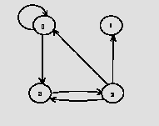
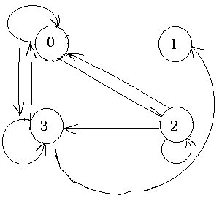
〖Example 11〗Let A={0,1,2,3}. R is the relation on the set A.
R ={(0,0),(0,3),(2,3),(3,2),(2,1),(2,0)}. R²=?
Solution:
  Using the definition
    R²={(0,0),(0,3),(0,2),(2,2),(3,3),(2,3),(2,0),(3,1),(3,0)}
  Using the digraph

Slide 13
9.4 Closures of Relations
3. Transitive Closure
Terminology:
A path of length n in a digraph G :
A sequence of edges (x₀, x₁),(x₁, x₂),. . . ,(x_{n-1}, x_{n})
Notation: x₀, x₁, x₂,. . . , x_{n-1}, x_{n}.
Cycle or circuit : If x₀ = x_{n} (n≧1)
For example,
a
b
d
c

Slide 14
9.4 Closures of Relations
The term path also applies to relation.
Why?
  Relation ↔ Digraph
How?
  There is a path of length n from a to b in R:
a, x₁, x₂,. . . , x_{n-1}, b such that (a, x₁)∈ R, (x₁, x₂)∈ R, …,( x_{n-1}, b)∈ R

Slide 15




9.4 Closures of Relations
【 Theorem 】 Let R be a relation on A. There is a path of
length n from a to b if and only if
Proof:
① Inductive basis
An edge from a to b is a path of length 1 which is in R¹ = R. Hence the assertion is true for n = 1.
Inductive step
There is a path of length n+1 from a to b if and only if there is an x in A such that there is a path of length 1 from a to x and a path of length n from x to b.
From the Induction Hypothesis,

Slide 16
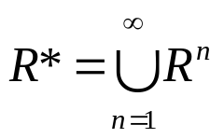
9.4 Closures of Relations
【Definition】 The connectivity relation denoted by R*, is the set of ordered pairs (a, b) such that there is a path (in R) from a to b:
〖Example 4〗 Let A = the set of people, R = {(x, y) | person x
is a parent of person y}. R* = ?

Slide 17


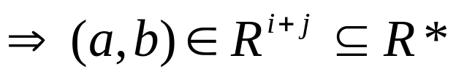
9.4 Closures of Relations
【 Theorem 】 t(R) = R*.
Proof:
① containing R
is a transitive relation
Suppose (a, c) and (c, b) are in R*. Show that (a, b) is in R*.
By the definition of R*,

Slide 18
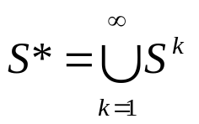
9.4 Closures of Relations
③ is the smallest transitive relation which contains R
Now suppose that S is any transitive relation which contains R. We must prove S contains R* to show R* is the smallest relation.
Since S is transitive, S^{n} ⊆S.
Furthermore, since
and S^{n} ⊆S, it follows that S* ⊆S
If R⊆S, then R* ⊆S*, because any path in R is also a path in S.
Therefore R* ⊆S*⊆S

Slide 19
9.4 Closures of Relations
【 Theorem 】 If |A | = n, then any path of length > n must
contain a cycle.
Proof:
If we write down a list of more than n vertices representing a path in R, some vertex must appear at least twice in the list (by the Pigeonhole Principle).

Slide 20




9.4 Closures of Relations
【Corollary】 If , then
【Corollary】 Let be the zero-one matrix of the
relation R on a set with n elements. The zero-one matrix
of the transitive closure is

Slide 21
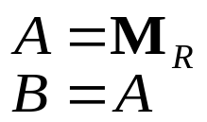
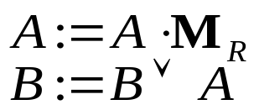
9.4 Closures of Relations
A Procedure for computing t(R)
for i := 2 to n
begin
end {B is the zero-one matrix for t(R)}
The complexity of algorithm:

Slide 22



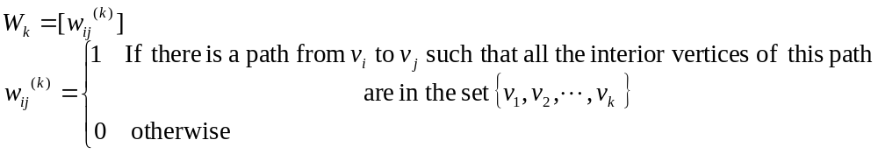

9.4 Closures of Relations
Warshall’s Algorithm
The interior vertices of a path:
Warshall’s algorithm is based on the construction of a sequence of zero-one matrices, such as
从vk充当内点开始

Slide 23
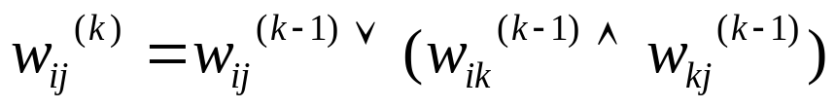
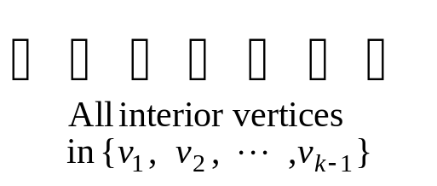
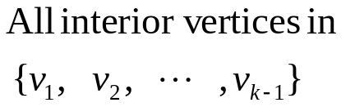
9.4 Closures of Relations
Case 1
V_{i}
V_{j}
V_{k}
Case 2
V_{i}
V_{j}

Slide 24

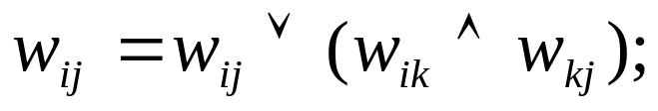


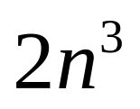
9.4 Closures of Relations
Warshall’s Algorithm
for k :=1 to n
begin
for i :=1 to n
begin
for j :=1 to n
end
end{ is
The complexity of algorithm:

Slide 25
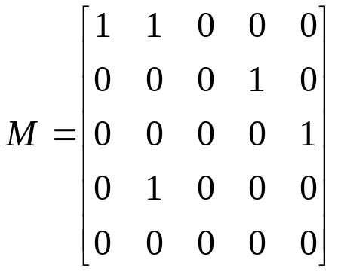
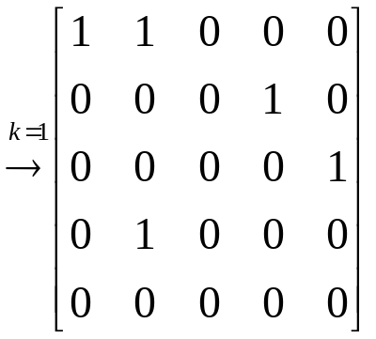
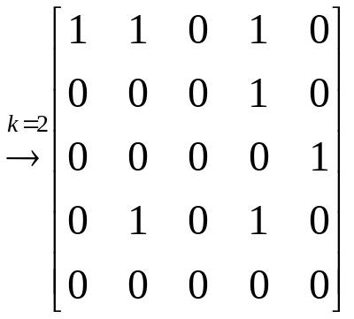
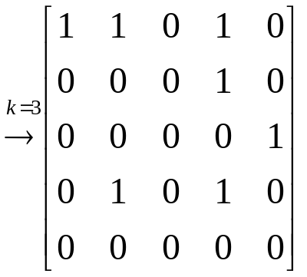
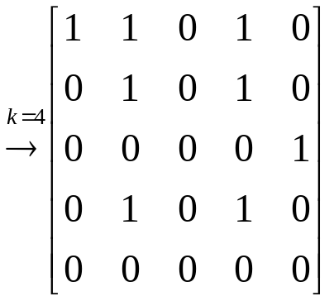
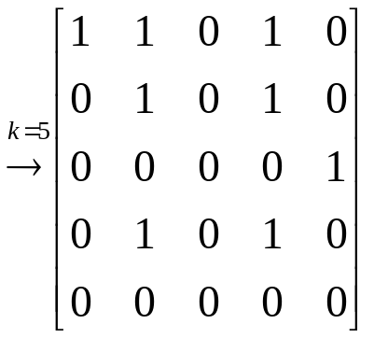
9.4 Closures of Relations
〖Example 3〗 Let
Solution:

Slide 26
Homework: (Due on May 13)
Sec.9.4 2, 6, 9(6), 11(6), 20, 28(a), 29
8th，7th

Slide 27
Chapter 9 Relations
9.1 Relations and Their Properties
9.2 n-ary Relations and Their Application
9.3 Representing Relations
9.4 Closures of Relations
9.5 Equivalence Relations
9.6 Partial Orderings

Slide 28
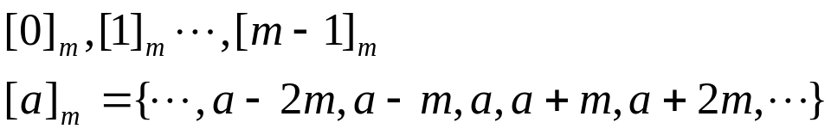
9.5 Equivalence Relations
〖Example 1〗 Congruence Modulo 3
[0]={…, -6, -3, 0, 3, 6, …}={ 3k | k ∈ Z }
[1]={…, -5, -2, 1, 4, 7, …}={ 3k+1 | k ∈ Z }
[2]={…, -4, -1, 2, 5, 8, …}={ 3k+2 | k ∈ Z }
Congruence Modulo m :
Congruence class Modulo m :

Slide 29
9.5 Equivalence Relations
1. Equivalence relations and equivalence classes
【Definition】A relation R on a set A is an equivalence relation if R is
        reflexive
        symmetric
        transitive
For example,
(2) The similarity relation between two triangles
(3) The equivalent relation between two formulas in proposition logic

Slide 30


9.5 Equivalence Relations
Terminologies:
a and b are equivalent
R is an equivalence relation, and (a , b)∈ R
Notation: a ~ b
the equivalence class of x
The set of all elements that are related to an element x of A
Notation:
a representative of the equivalence class

Slide 31









9.5 Equivalence Relations
〖Example 1〗 Congruence Modulo 3
Show that R is an equivalence relation. And find its equivalence classes.
Solution:
reflexive
R is reflexive, since
② symmetric
③ transitive

Slide 32
9.5 Equivalence Relations
[0]={…, -6, -3, 0, 3, 6, …}={ 3k | k ∈ Z }
[1]={…, -5, -2, 1, 4, 7, …}={ 3k+1 | k ∈ Z }
[2]={…, -4, -1, 2, 5, 8, …}={ 3k+2 | k ∈ Z }
Congruence Modulo m :
Congruence class Modulo m :

Slide 33

9.5 Equivalence Relations
〖Example 2〗 Suppose that A is a nonempty set, and f is a
function that has A as its domain. Let R be the relation on A
consisting of all ordered pairs (x,y) where f(x)=f(y).
  (1) Show that R is an equivalence relation.
  (2) What are the equivalence classes of R.
Solution:
  (1)
reflexive
② symmetric
③ transitive
(2)

Slide 34
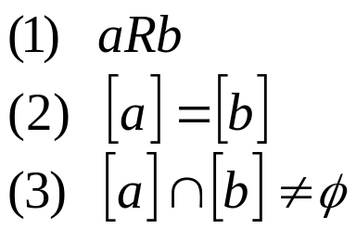




9.5 Equivalence Relations
【 Theorem 1】 Let R be an equivalence relation on a set A.
The following statements are equivalent：
Proof:
Show that (1) implies (2)

Slide 35






9.5 Equivalence Relations
Show that (2) implies (3)
R is reflexive ⇒ [a] is nonempty
Show that (3) implies (1)

Slide 36





9.5 Equivalence Relations
2. Equivalence relations and partitions
【Definition】A partition of set A is a collection of disjoint nonempty subsets of A that have A as their union.
Let be a collection of subsets of A. Then the collection forms a partition of A if and only if
Notation:
A₂
A₁
A₄
A₃
A₅

Slide 37






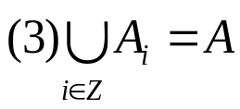

9.5 Equivalence Relations
【 Theorem 2】 Let R be an equivalence relation on a set A.
Then the equivalence classes of R form a partition of A.
Conversely, given a partition of the set A, there is
an equivalence relation R that has the sets ,
as its equivalence classes.
an equivalence relation on a set A ↔ a partition of A
Proof:
the equivalence class of R :

Slide 38


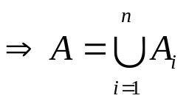









9.5 Equivalence Relations

Slide 39
9.5 Equivalence Relations
〖Example 3〗 Find the partition of the set A from R.
Solution:
4
[0]={0}
[1]={1,2,3}
[4]={4,5}
pr(A)={ [0], [1], [4]}
1
0
3
2
5

Slide 40

9.5 Equivalence Relations
Question:
Congruence Modulo m
Question:
|A|=3. How many different equivalence relations on the set A are there?
Solution:
an equivalence relation on a set A ↔ a partition of A

Slide 41
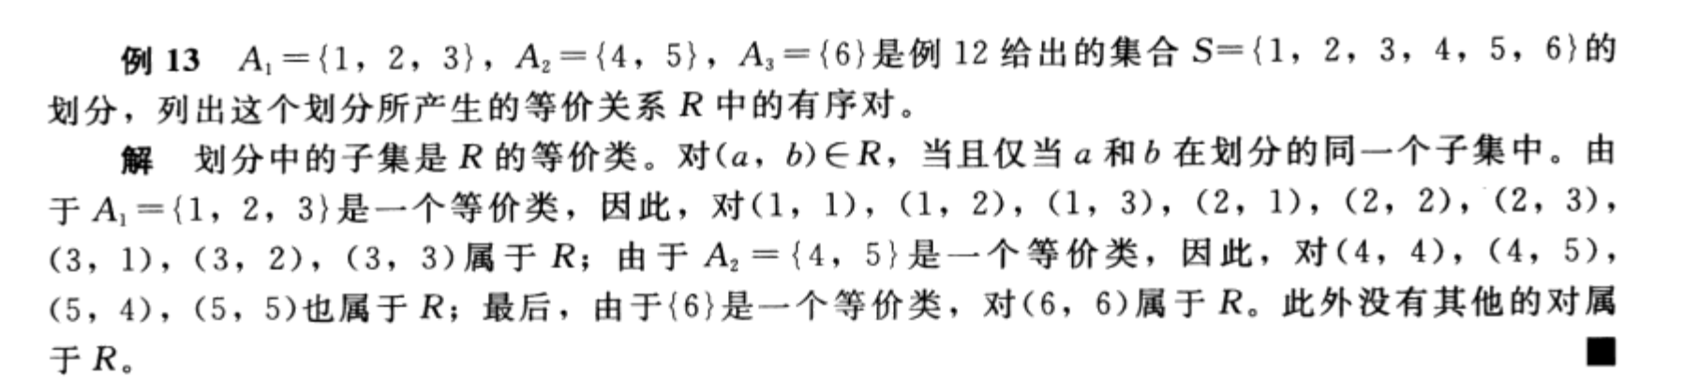
9.5 Equivalence Relations
2. Equivalence relations and partitions
Equivalence relation from partitions

Slide 42




9.5 Equivalence Relations
3. The operations of equivalence relations
【 Theorem 3】 If are equivalence relations on A, then
is a equivalence relation on A.
Proof:
It suffices to show that the intersection of
  reflexive relations is reflexive,
  symmetric relations is symmetric,
and
  transitive relations is transitive.

Slide 43




9.5 Equivalence Relations
3. The operations of equivalence relations
【 Theorem 3】 If are equivalence relations on A, then
is equivalence relations on A.
Proof:
It suffices to show that the intersection of
  reflexive relations is reflexive,
  symmetric relations is symmetric,
and
  transitive relations is transitive.

Slide 44




9.5 Equivalence Relations
3. The operations of equivalence relations
【 Theorem 3】 If are equivalence relations on A, then
is equivalence relations on A.
Proof:
It suffices to show that the intersection of
  reflexive relations is reflexive,
  symmetric relations is symmetric,
and
  transitive relations is transitive.

Slide 45





9.5 Equivalence Relations
【 Theorem 4】 If are equivalence relations on A, then
is a reflexive and symmetric relation on A.
Proof:
(1) reflexive
(2) symmetric
Question: transitive?

Slide 46
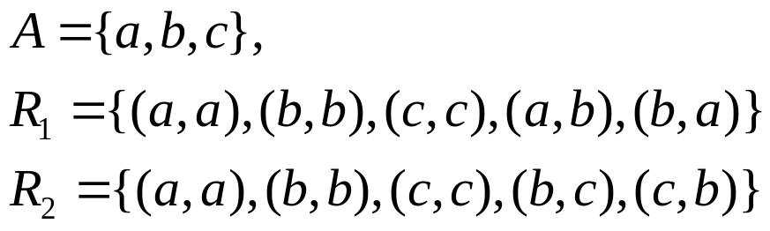

9.5 Equivalence Relations
〖Example 4〗
Is a transitive relation ?
Solution:

Slide 47

9.5 Equivalence Relations
【 Theorem 】 If are equivalence relations on A, then
is an equivalence relation on A.
Proof:
(1) reflexive
(2) symmetric
(3) transitive

Slide 48
Homework: (Due on May 13)
Sec. 9.5 3, 10, 16, 36(b), 39, 41
7th, 8th

